Slide 1
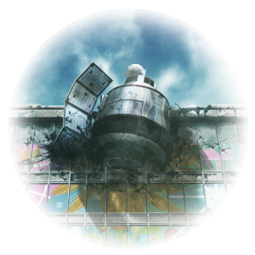
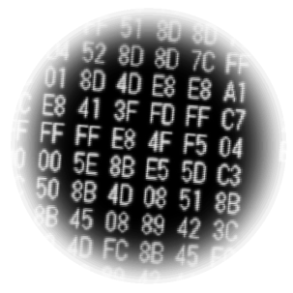
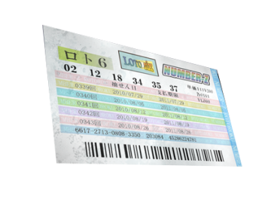
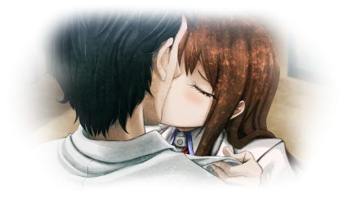
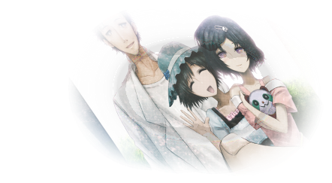
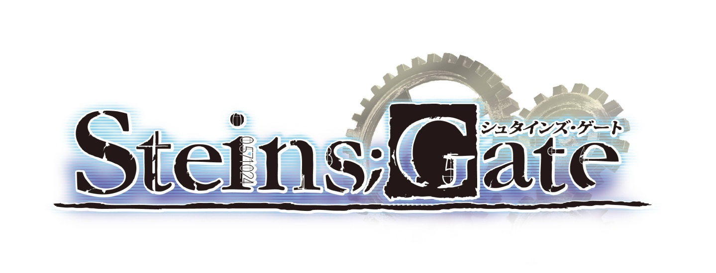
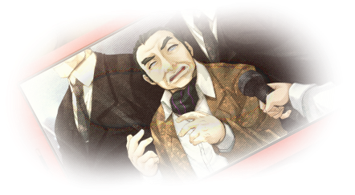
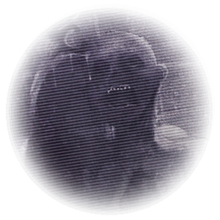
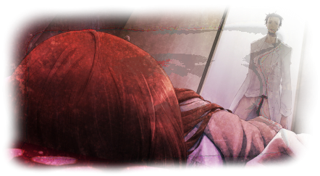
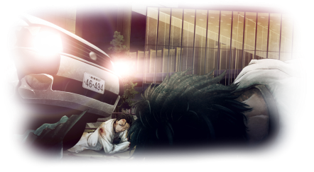
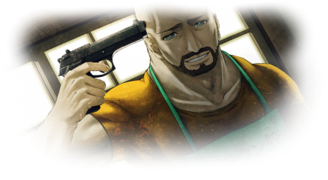
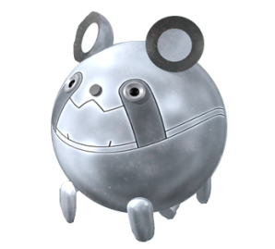
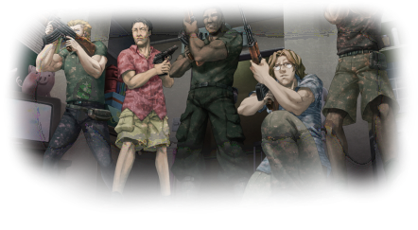
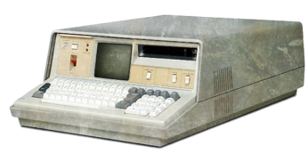
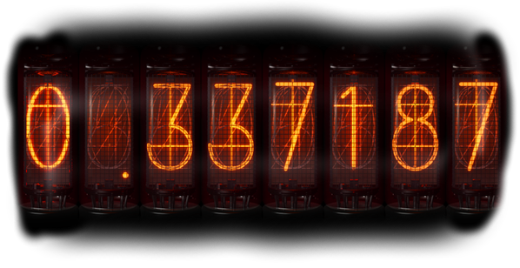
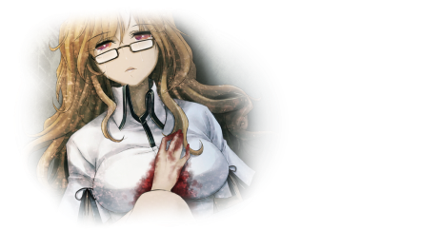
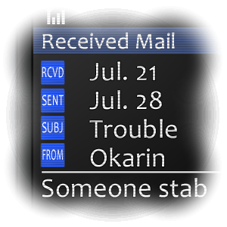
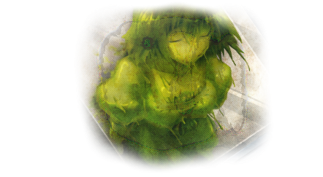
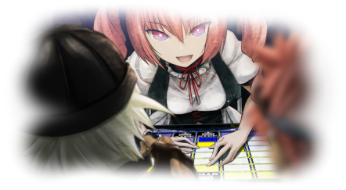
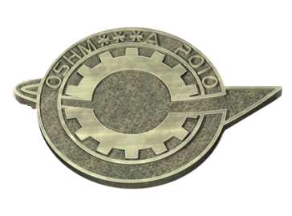
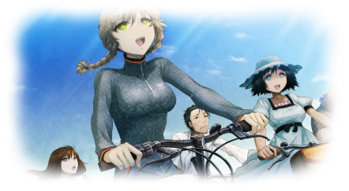

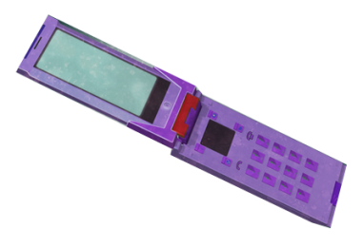
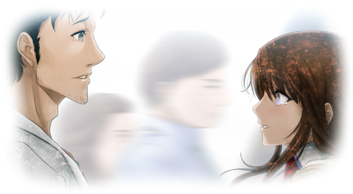
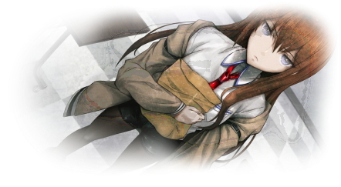
1921
1936
1961
1972
1975
1985
1993
1998
1999
2000
2001
2002
2002-2005
2009
2010
JUL
JUL 21
JUL 24
JUL 27
JUL 28
JUL 29
JUL 31
AUG 1
AUG 2
AUG 3
AUG 4
AUG 5
AUG 6
AUG 9
AUG 11
Faris convinces her father to promote moe culture in Akihabara
Moeka does not attempt to steal the IBM 5100
AUG 7
AUG 10
Suzuha's time machine lands on the roof of Radio Kaikan with Rintaro (F)
Suzuha and Rintaro (F) return to 21\8
The FGL send Itaru RaiNet strategies via D-Mail
Luka expresses a desire to be female, and Kurisu mentions an idea about vegetables
Suzuha's time machine is damaged by rain
Faris' father travels by plane and dies
Suzuha posts online about time travel as John Titor
Kurisu develops a theory of time travel
Rintaro sees Kurisu in a pool of blood and sends Itaru a D-Mail
Rintaro acquires the IBM 5100 at Yanabayashi Shrine
The FGL sends Luka's mother a D-Mail page
Faris promotes moe culture in Akihabara
Moeka receives a D-Mail from FB
Itaru attends the Faris Cup and loses
The FGL send a D-Mail to Rinataro
Faris sends a D-Mail to her father
Rintaro (F) kills Kurisu
Moeka receives multiple D-Mails
Suzuha acquires an IBM 5100
Luka sweeps the main shrine
Rintaro receives a video D-Mail
Rintaro (F) returns to 21\8
Moeka steals the IBM 5100
Moeka sends herself a D-Mail
Rintaro sends himself a D-Mail
Suzuha arrives from 2036
Suzuha travels to 1998
Luka is born male
Suzuha arrives from 1975
Suzuha travels to 2010
MayQueen Nyan² opens
Rintaro (F) saves Kurisu
Itaru receives a D-Mail
Suzuha travels to 1975
✉ *2*281311223134524040322512502137493 EAT VEG 4 HEALTHY KID
✉ 021219343537Buy LOTO SIXsure to win!
✉ Don't listen to Chris Pursue Suzuha!
✉ Okarin’s a perv
A gelified Mayuri appears
Faris' father receives a D-Mail
Suzuha dies of illness
The FGL is founded
Rintaro receives a D-Mail
Rintaro receives a D-Mail
Kurisu is not attacked
Rintaro receives a D-Mail
Moeka receives a D-Mail
Rintaro receives a D-Mail
Rintaro receives a D-Mail
Suzuha arrives from 2010 with her memories
Suzuha regains her memories
Faris starts participating in RaiNet tournaments
SERN sends people back in time
The FGL create the Phonewave
Rintaro receives a second D-Mail
A jellyman appears in Kyoto, Japan
Faris' father travels by train and lives
A jellyman appears in Pau, France
Nakabachi's conference is cancelled
Luka's mother receives a D-Mail page
Faris' father receives a second D-Mail
A jellyman appears in New York, USA
A jellyman appears in Streymoy, Faroe Islands
The FGL experiment and send a D-Mail
The FGL experiment and send a D-Mail
A jellyman appears in Tamil Nadu, India
SERN starts sending people back in time
Rintaro and Mayuri visit Radio Kaikan to attend Nakabachi's conference
The FGL experiment and send a D-Mail
Luka shows Rintaro the 4th prize lottery ticket
Suzuha gives the IBM 5100 to Faris' father
Luka's mother eats a lot of vegetables and Luka is born female
Faris' father sells the IBM 5100 to pay the ransom
Faris donates the IBM 5100 to Yanabayashi Shrine
Moe culture is not promoted in Akihabara
Luka sweeps the storehouse and breaks the IBM 5100
Itaru receives a D-Mail which is recorded by Echelon
Rintaro receives a D-Mail and tells Luka to buy a lottery ticket, who fills out 1 number incorrectly
Suzuha's time machine lands in the roof of Radio Kaikan
Suzuha posts online about time travel and SERN as John Titor
The FGL hack into SERN and discover IBM 5100 code
The IBM 5100 is not at Yanabayashi Shrine
The FGL experiment and send multiple D-Mails
Rintaro follows and catches Suzuha and she stays in 2010
Suzuha arrives from 2010 with amnesia
Luka's mother receives a second D-Mail page
Faris' father receives a second D-Mail
Suzuha writes a letter to Rintaro and commits suicide
The IBM 5100 is not at Yanabayashi Shrine
Suzuha attends a time machine meet to find her father but does not find him
The FGL begin upgrading the Phonewave for time leaping
✉ Stop pursuit last mail is SERN trap
“Nothing is coincidence, everything is inevitable.”
✉ JK on ransomI luv u papaSee you soon
✉ Model changeDo it now!!!B4 sold out!
✉ GG01 rocks! Switch now or regret it!
✉Change now! Ur phone is cursed!
✉ Do NOT go!! Not @shrine!It's a trap!
Mayuri drops the Upa and Kurisu places it in the envelope containing her paper
Nakabachi attacks Kurisu and steals the envelope
Rintaro (P) sees Kurisu lying in a pool of blood
Rintaro (F) uses the capsule machine and gets the metal Upa
Rintaro (P) uses the capsule machine and gets an ordinary Upa
Kurisu confronts Rintaro (P) about their encounter
Rintaro (F) and Suzuha stage Kurisu's death
Suzuha's time machine lands on the roof of Radio Kaikan with Rintaro (F)
Rintaro (F) intervenes and is stabbed
Rintaro (P) receives a video D-Mail
Rintaro (P) hears Rintaro (F) scream
Rintaro (P) sends Itaru a D-Mail
✉ Stop search.PC unneeded.Stand by.
Kurisu's paper is destroyed
Rintaro returns to researching time travel
Rintaro sends himself 2 D-Mails
Rintaro (F) encounters Kurisu
Rintaro (F) hides in the hallway
Rintaro (F) returns to 21\8
Rintaro returns from 28\7
Suzuha travels to 1975
Rintaro meets Kurisu
World War III
Rintaro dies
Suzuha arrives from 2000
Rintaro gives up
Suzuha is born
Nae kills Rintaro
Itaru dies
Suzuha travels to 2010
Nae time leaps to 15\8\10
Itaru builds a time machine
SERN confiscates the Time Leap Machine
SERN builds a time machine
Rintaro and Mayuri visit Radio Kaikan for Nakabachi's conference
Nakabachi's conference is cancelled
Rintaro (P) uses the capsule machine and gets the metal Upa
Rintaro (F) intervenes and accidently kills Kurisu
Suzuha and Rintaro (F) return to 21\8
The metal Upa sets off the metal detector and Nakabachi takes the envelope out of his checked luggage
Suzuha and Rintaro travel to 28\7
Rintaro receives a D-Mail and sees Nakabachi on TV
Suzuha and Rintaro travel to 28\7
Suzuha's time machine lands in the roof of Radio Kaikan
Itaru experiments with the Phonewave
A fire breaks out on Nakabachi's plane
Suzuha and Rintaro return from 28\7
Rintaro views the video D-Mail again and realises how to save Kurisu
Rintaro sends Moeka a D-Mail with FB's phone
Mayuri is hit by a car
Mayuri does not die
The FGL deletes the first D-Mail from SERN's IBM 5100 database
The FGL deletes the first D-Mail from SERN's IBM 5100 database
Mayuri does not die
Moeka does not die
Mayuri does not die
Mayuri does not die
Mayuri dies
Mayuri does not die
Tennouji does not die
Rintaro chooses Mayuri
Rintaro confesses to Kurisu
Kurisu finishes the Time Leap Machine
Rintaro tries to save Mayuri
Rintaro takes Mayuri to South America
Mayuri does not die
Kurisu demands that Rintaro save Mayuri
Rintaro cripples SERN's servers
Rintaro realises saving Mayuri will kill Kurisu
Rintaro gets Mayuri admitted to a hospital
Rintaro hires bodyguards to protect Mayuri
The FGL dismantle the Phonewave

